Slide 1
CONTRACEPTIVE LOGISTICS MANAGEMENT.
ONYANGO M. HUMPHREY
BSCN. MOI UNIVERSITY

Slide 2
GUIDELINES FOR PROPER STORAGE OF CONTRACEPTIVES.

Slide 3
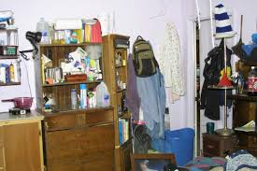

Slide 4
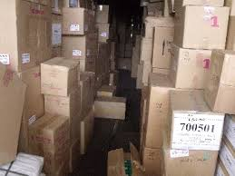

Slide 5


Slide 6
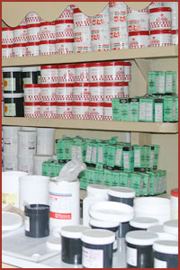

Slide 7
Guidelines For Proper Storage:
Security
Location
Space
Cleanliness
Temperature regulation (cold chain, air conditioning)

Slide 8
IMPORTANCE OF PROPER STORAGE
Avoids stockout/ spoilage
Contraceptives issued are safe and of high quality
Reduced wastage
Monitors shelf life and product quality
Reduce loss of funds
Easier to select and distribute commodity
Ensure disposal of expired contraceptives

Slide 9
Proper storage guidelines
Clean and disinfect store room regularly
Store contraceptives in a dry, well lit and well ventilated room out of direct sunlight
Secure storeroom from water penetration
Ensure fire safety equipment is available and accessible
Store cartons of condoms away from electric motors and fluorescent light
Stack contraceptives cartons at least 10cm away from the walls and other stacks and not more than 2.5m high

Slide 10
CT’D
Arrange cartons so that identification labels, expiry dates and manufacturing dates are visible
Store contraceptives in a manner accessible for FEFO ,counting and general management
Store contraceptives separately away from insecticides, chemicals, old files, office supplies and other materials
Separate and dispose off damaged or expired contraceptives without delay

Slide 11
First to Expire, First Out (FEFO)
Ensures that the quality of contraceptives distributed to clients is maintained and that the contraceptives have not expired on the shelf.
Cartons with earliest expiry dates should be distributed first, cartons with the later expiry dates should not be distributed until all supplies dated earlier have been exhausted
Ensure that the cartons are clearly marked with their expiry dates in large, easy to read numbers

Slide 12
FIFO is important because: (FEF0)
It avoids wastage
It is easier to issue contraceptives because oldest products are issued first
It can create some space because expired stock gets moved out of the inventory
It allows one to know when stock is in excess so that extra stock can be moved more easily to another facility where it is needed.

Slide 13
SHELF LIFE AND FACTORS THAT AFFECT QUALITY

Slide 14
Introduction
Shelf life is the length of time the contraceptive may be stored without affecting its usability, safety and potency
If proper storage guidelines are not followed the shelf life of the contraceptive will be shortened

Slide 15
Factors that affect shelf life
Rain
Heat
Sunlight
Chemical damage
Inadequate ventilation
Fluorescent light

Slide 16
QUALITY ASSURANCE

Slide 17
The service provider should spot check or do a visual examination before distributing contraceptives to clients to make sure that they are in good shape and of the best quality.

Slide 18
Visual inspection
Check for:
Colour
Number of pills
Crushed pills
Broken vials or injectables
Missing or damaged items
Syringes missing or damaged

Slide 19
Package integrity
Open or damaged boxes or packets
Leaking or sticky packages
Check expiry dates
Client feedback
Client reports of unusual colour or odor
Missing or broken pills
Condoms that break
Take all client feedback regarding the quality of the product and gather as many details as possible from the client. Report problems to the DPHSCN.

Slide 20
Actions to take if quality problems occur
Visual inspection: Check other stock for similar problems
Do not issue the product
Set the products aside
Report the problems to the next higher level
Do not accept delivery of stock that looks damaged
Do not issue the products

